Slide 1
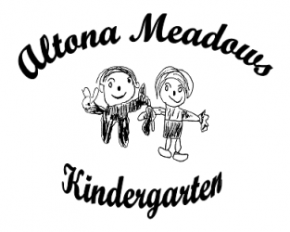
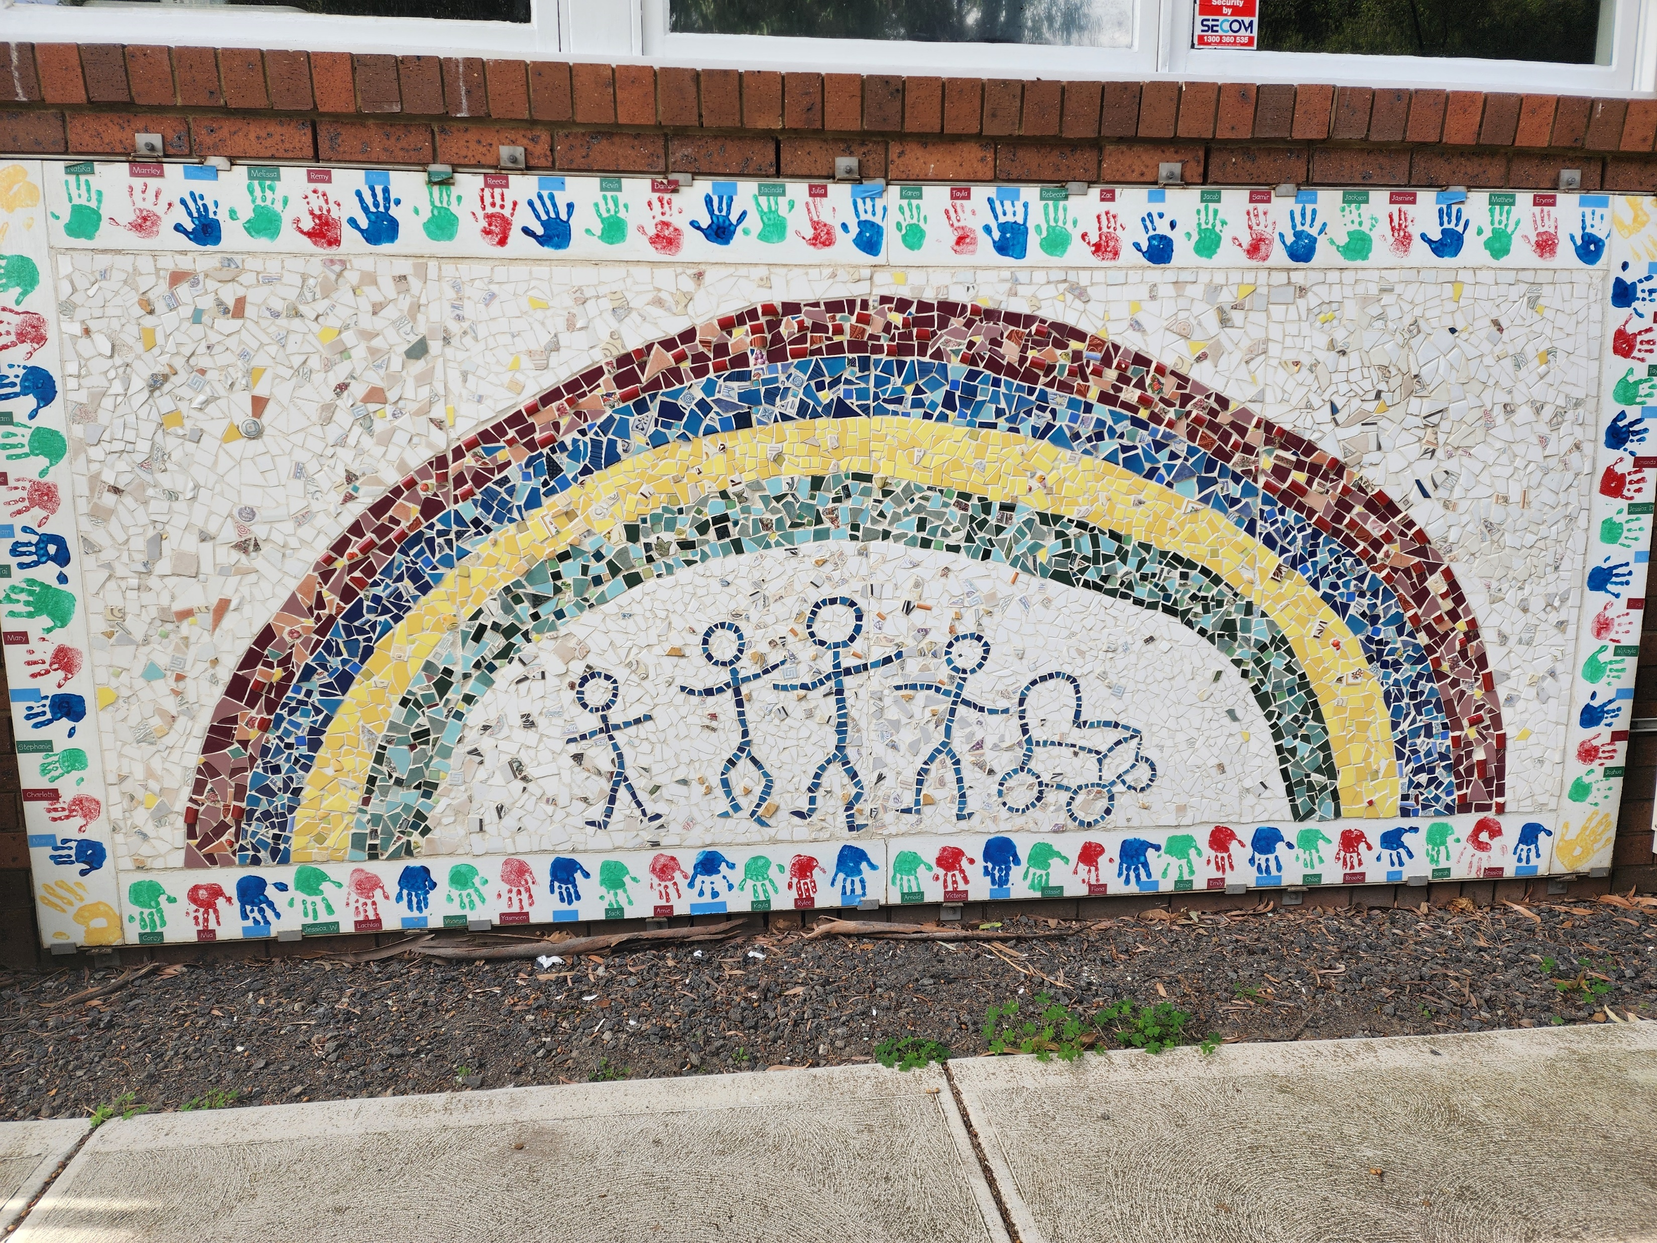
Altona Meadows Kindergarten

Slide 2

Altona Meadows Children’s Acknowledgement to Country
Here is the land,
Here is the sky,
Here is my kinder group,
And here am I.
We play and learn today on Bunurong land,
Our first nation people,
We walk hand in hand.
We acknowledge the Bunurong people of the Kulin nation,
And pay our respects to the elders, past, present and emerging.

Slide 3
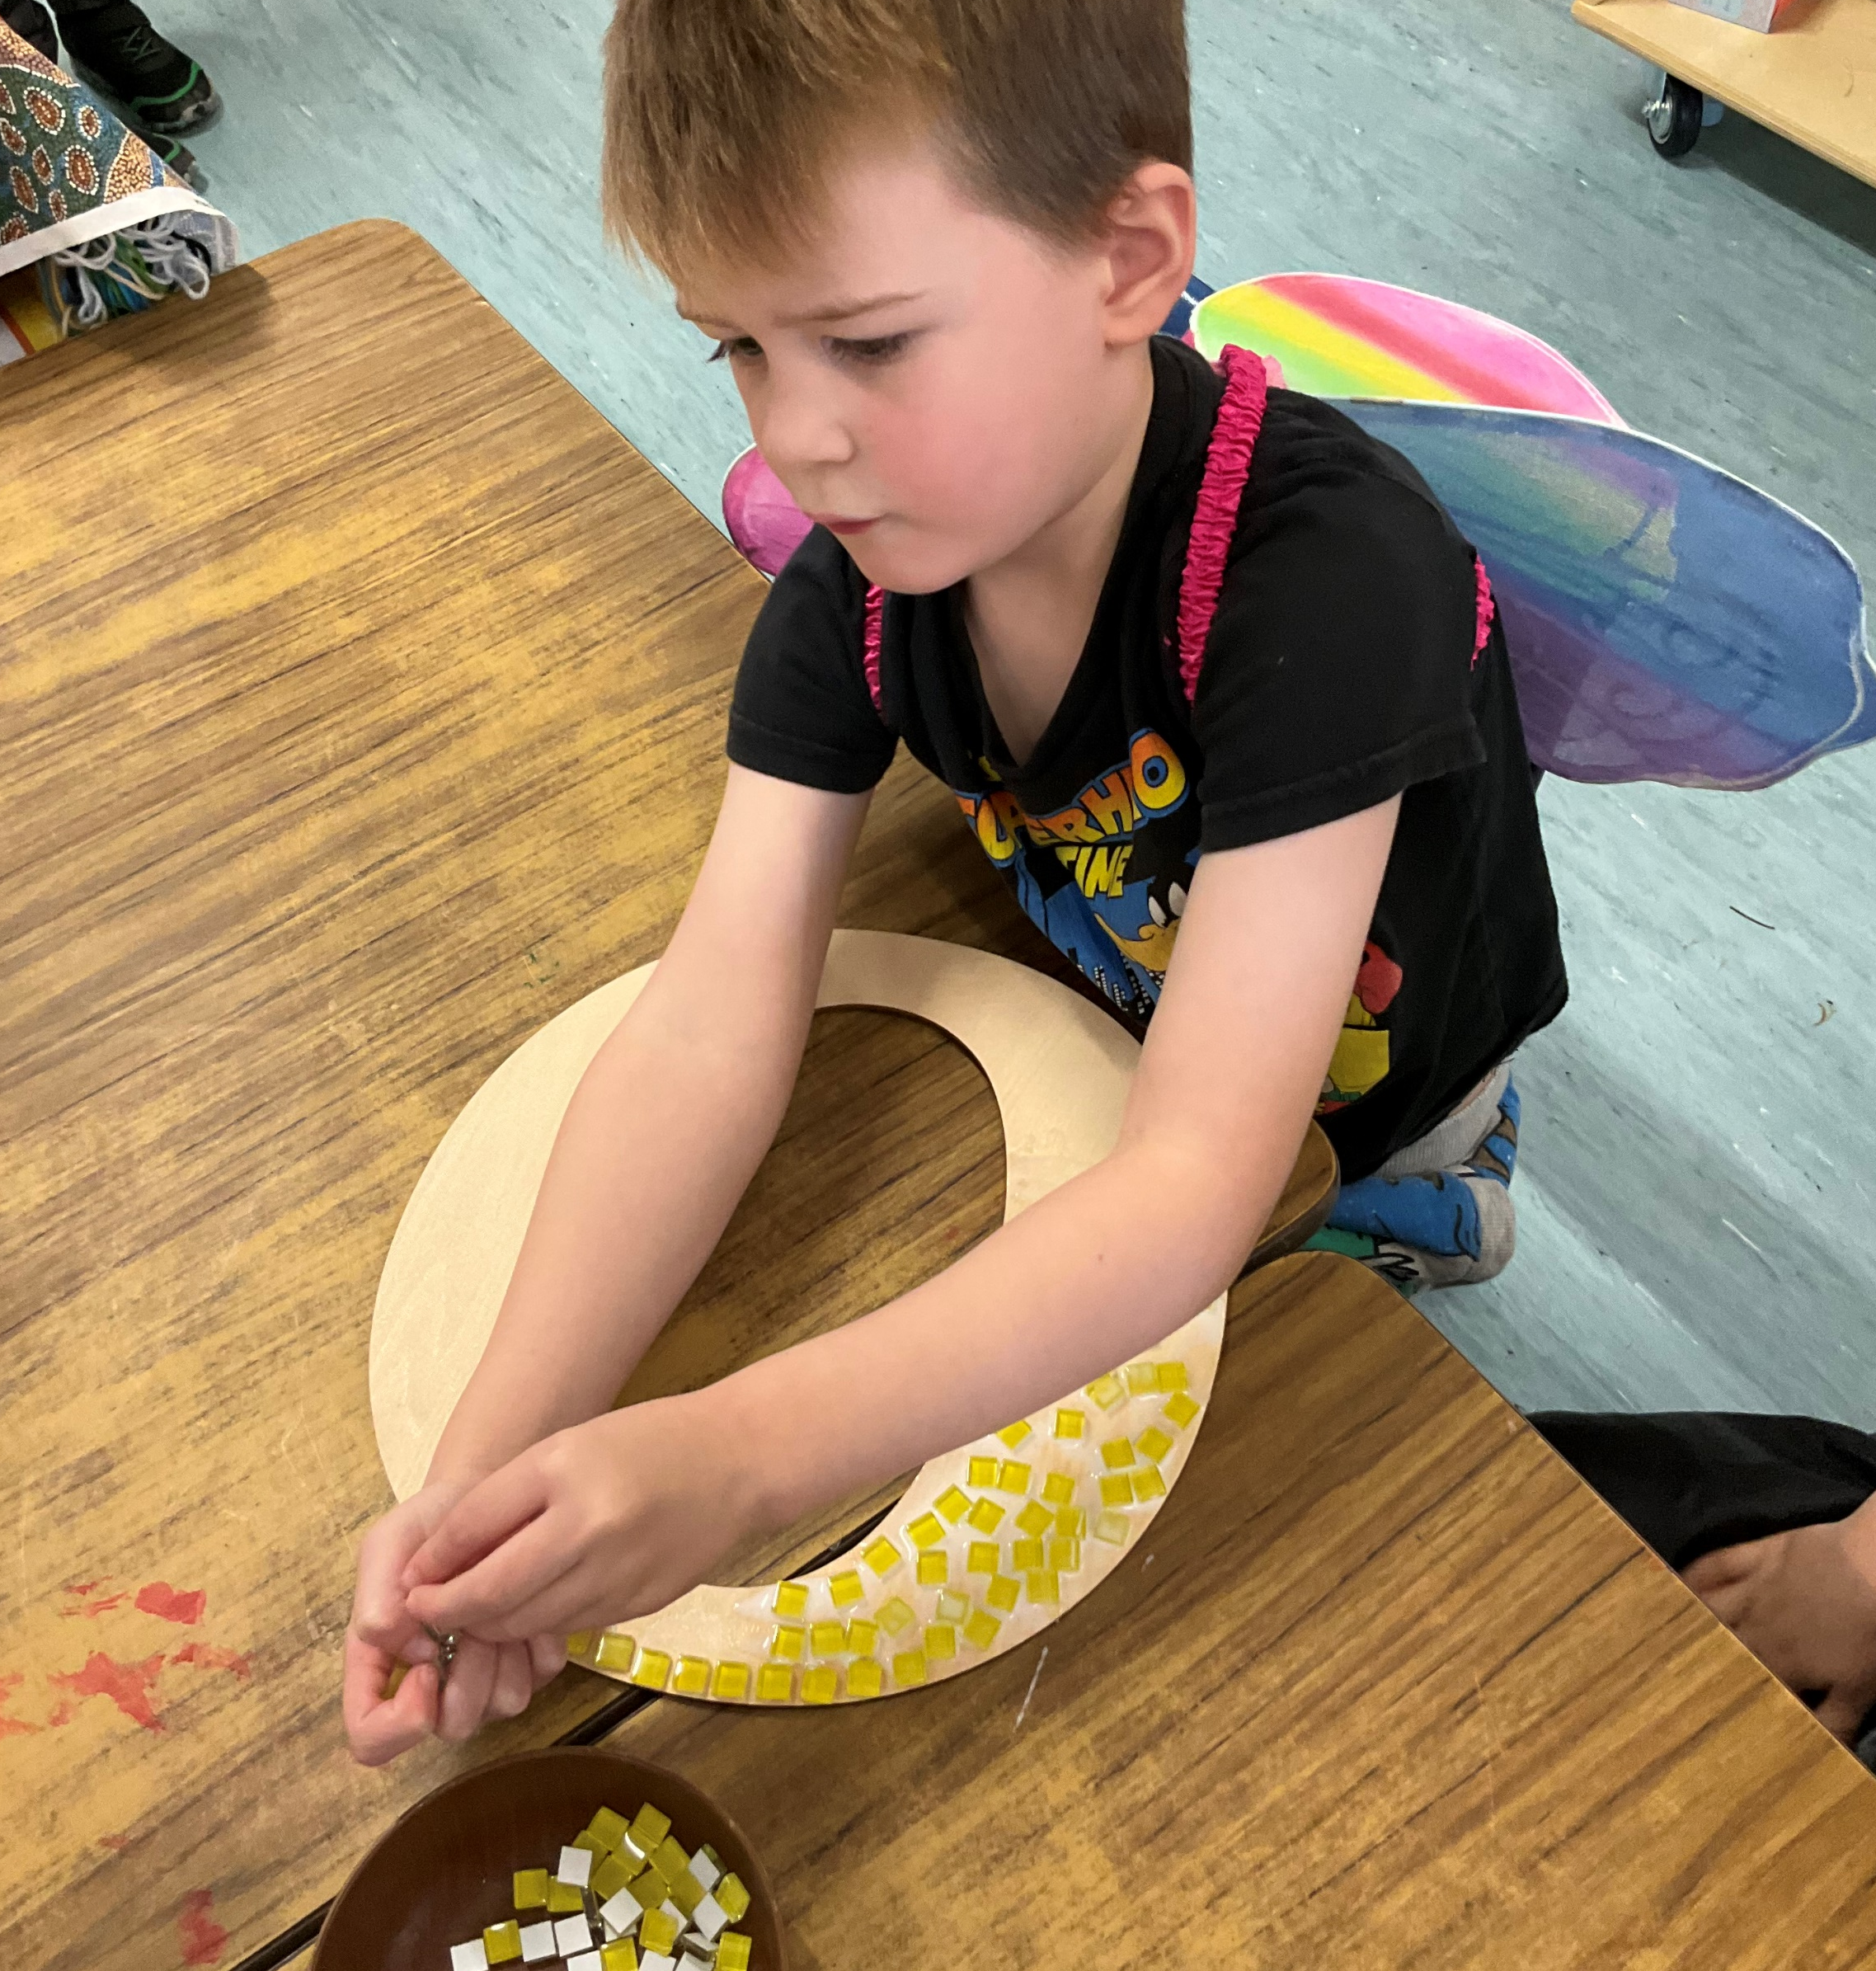
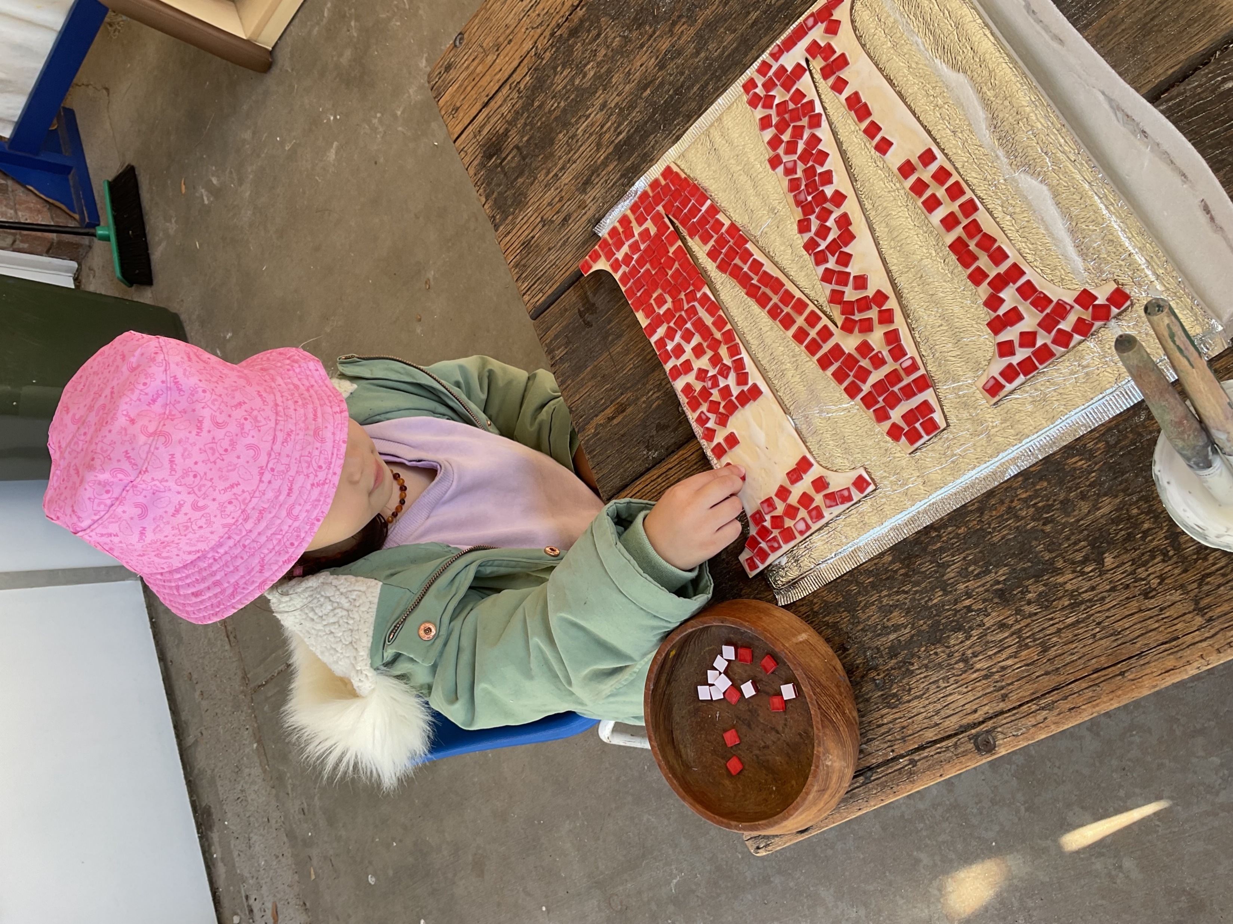
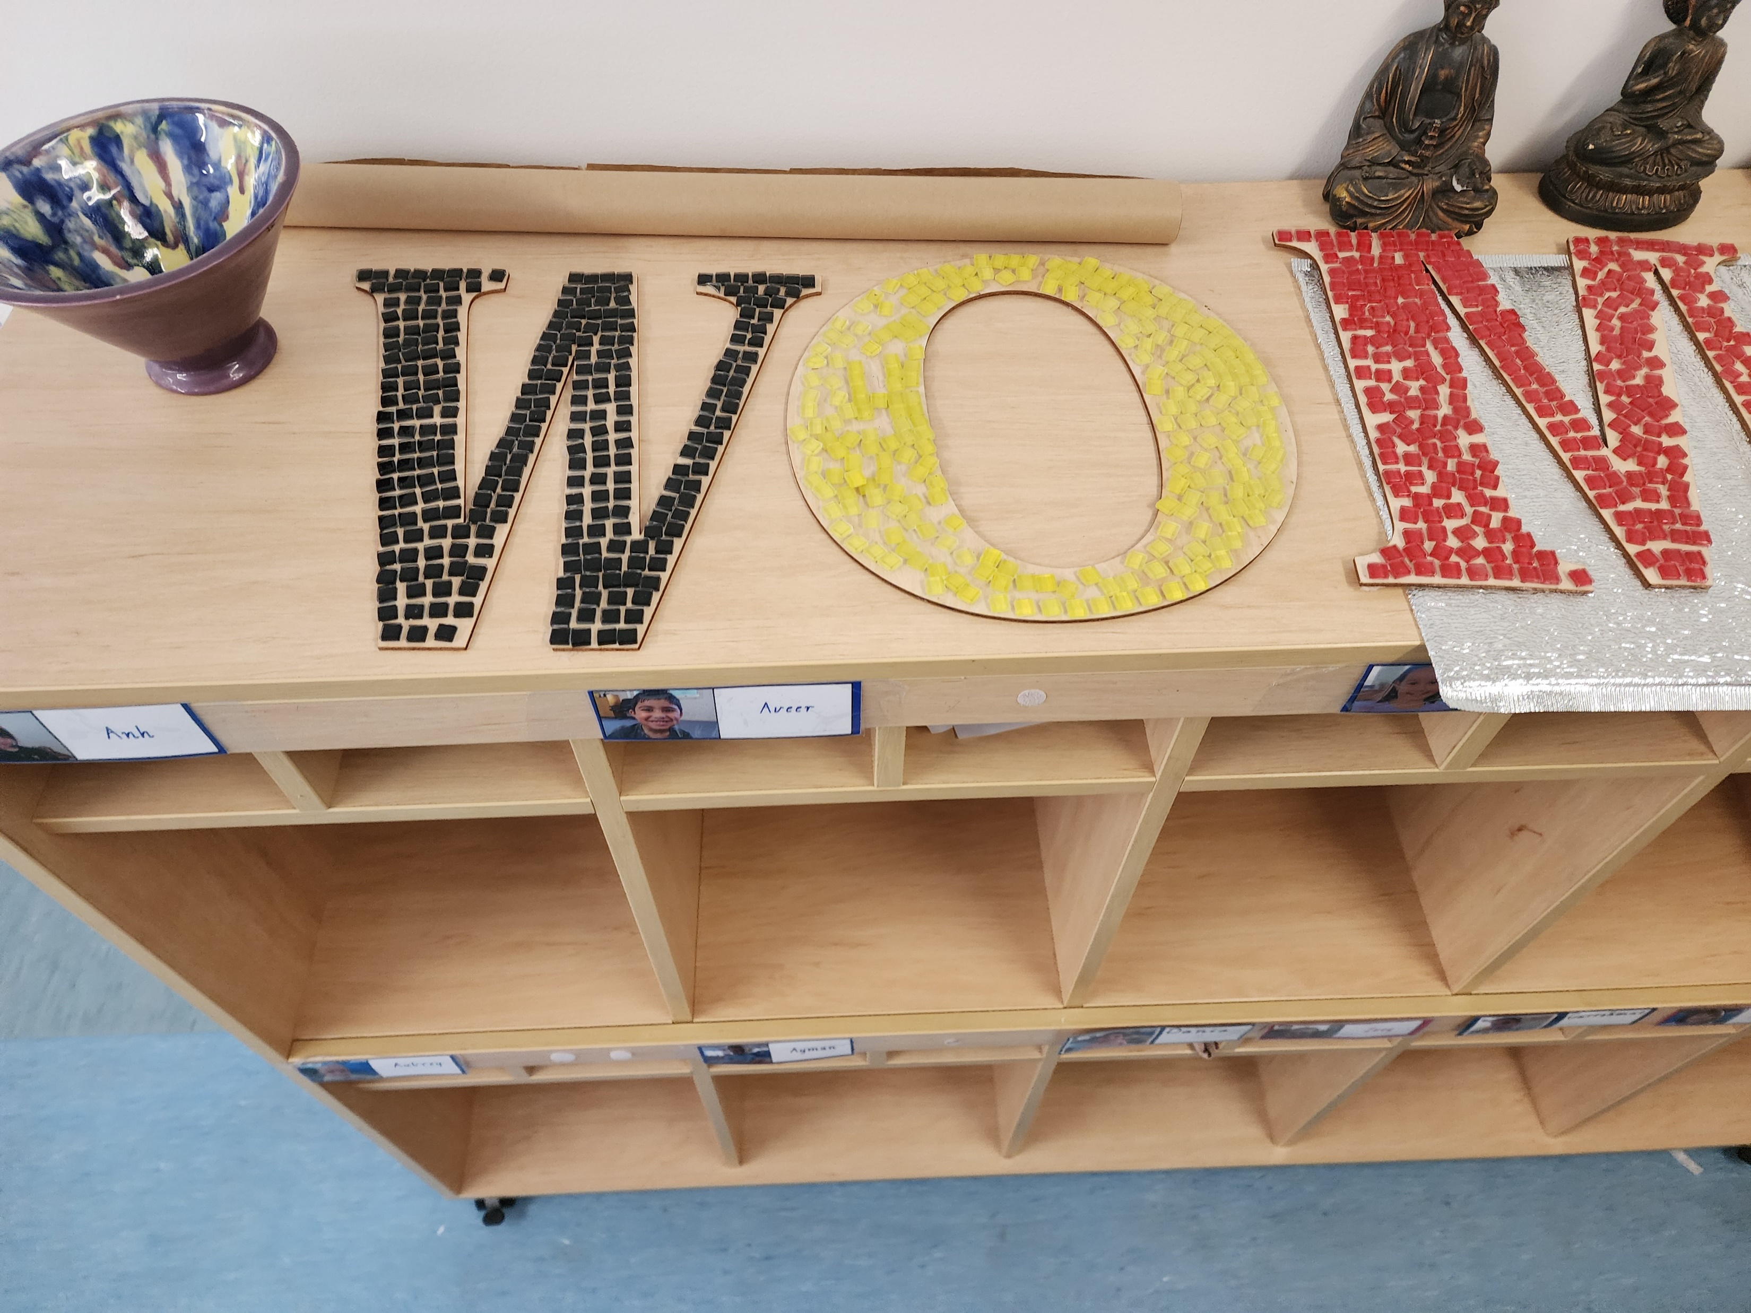
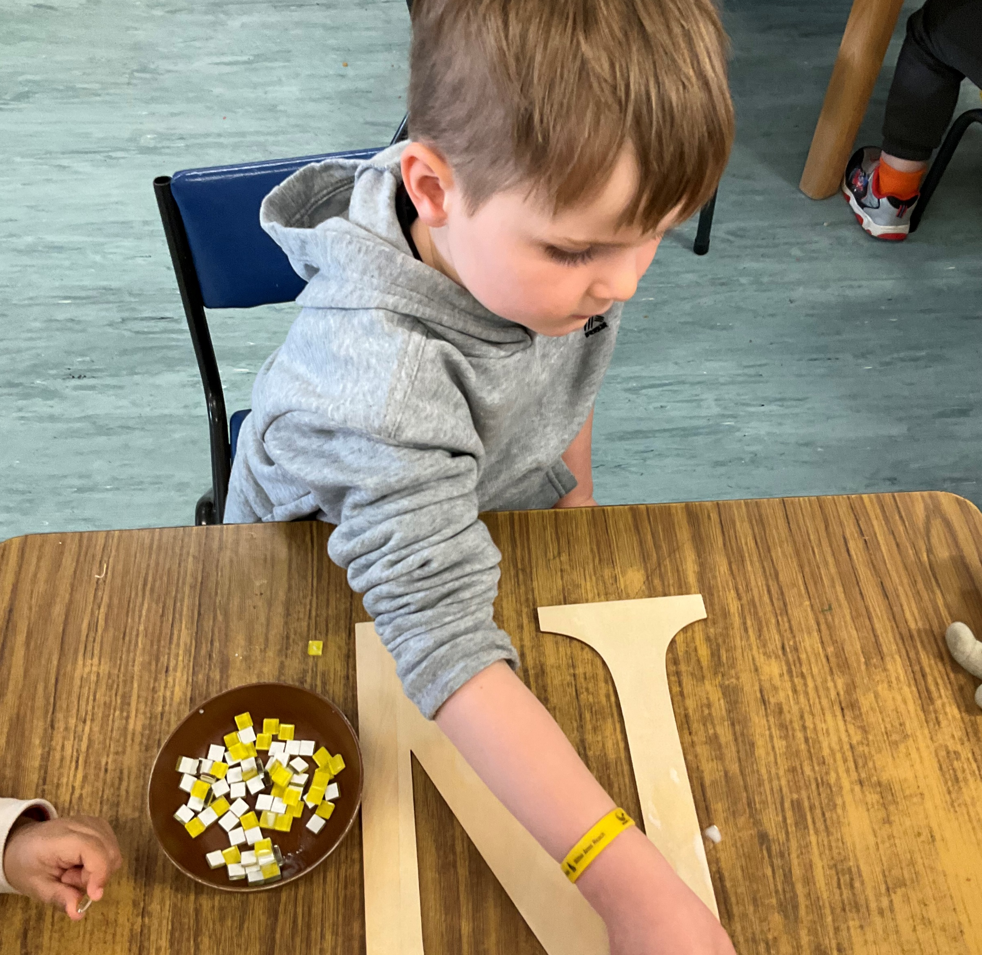
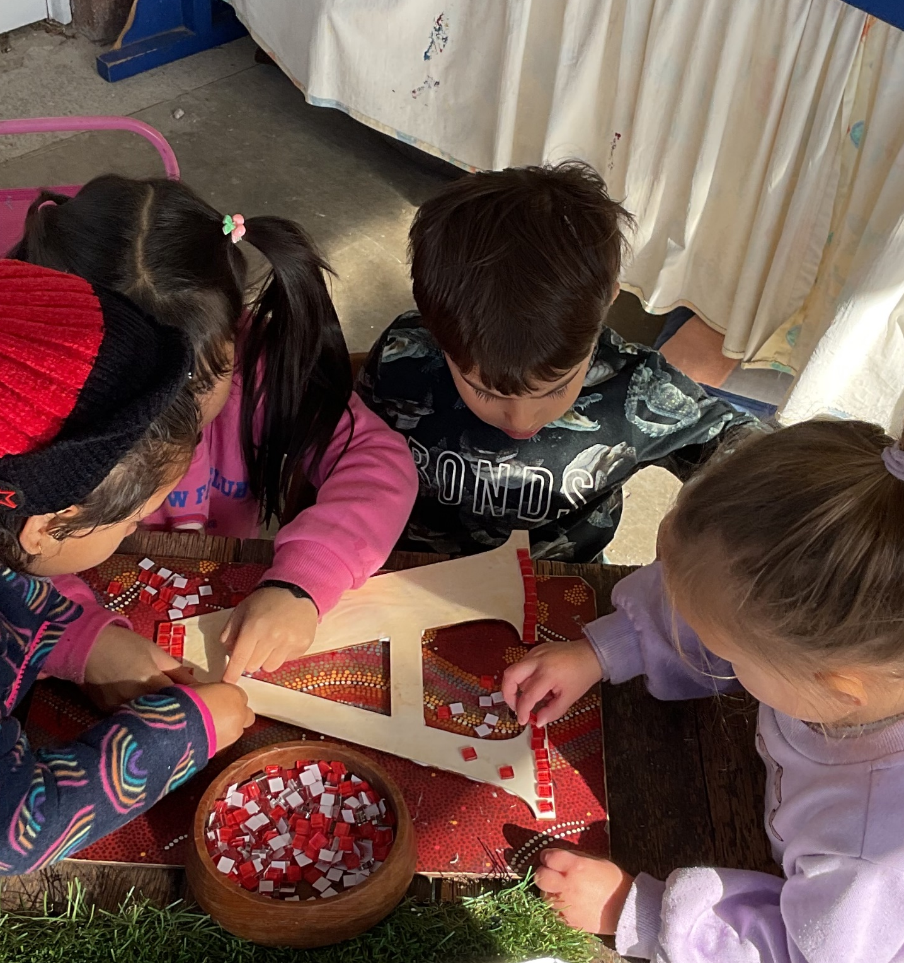
At our service, we strongly advocate for involving children in decision-making processes and involving them in projects that will have a lasting impact on our kindergarten. Currently, we are working on a project to create a sign that will be displayed at our service, welcoming all visitors with the word "wominjeka". Children, educators and families are involved in this project and we look forward to it being placed at the entrance of our kindergarten, welcoming all families and supporting our commitment to the cultural safety of our Aboriginal children and families.
In addition to this project, we are establishing a community pantry and are currently in the process of planning a community vegetable garden. These initiatives aim to foster a sense of togetherness and promote a sustainable and healthy lifestyle within our community.

Slide 4
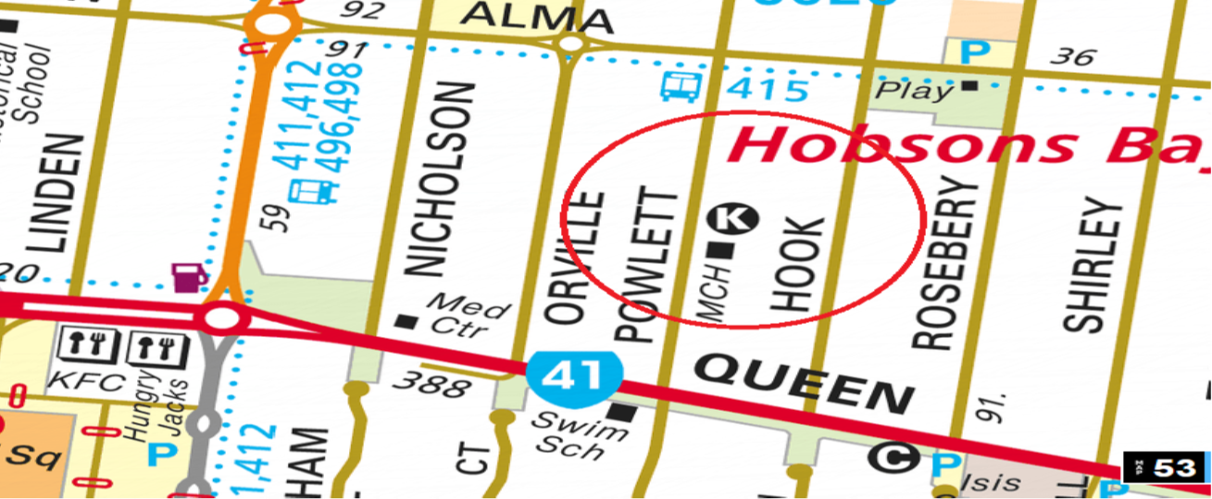
Phone: 9369 3346 / 0413483335
Email: altona.meadows.kin@kindergarten.vic.gov.au
Admin Hours: Monday-Thursday 10.00am – 3.00pm
Address: 65 – 67 Powlett Street Altona Meadows
Website: https://www.altonameadowskindergarten.kindergarten.vic.gov.au
Facebook: Altona Meadows Kindergarten

Slide 5
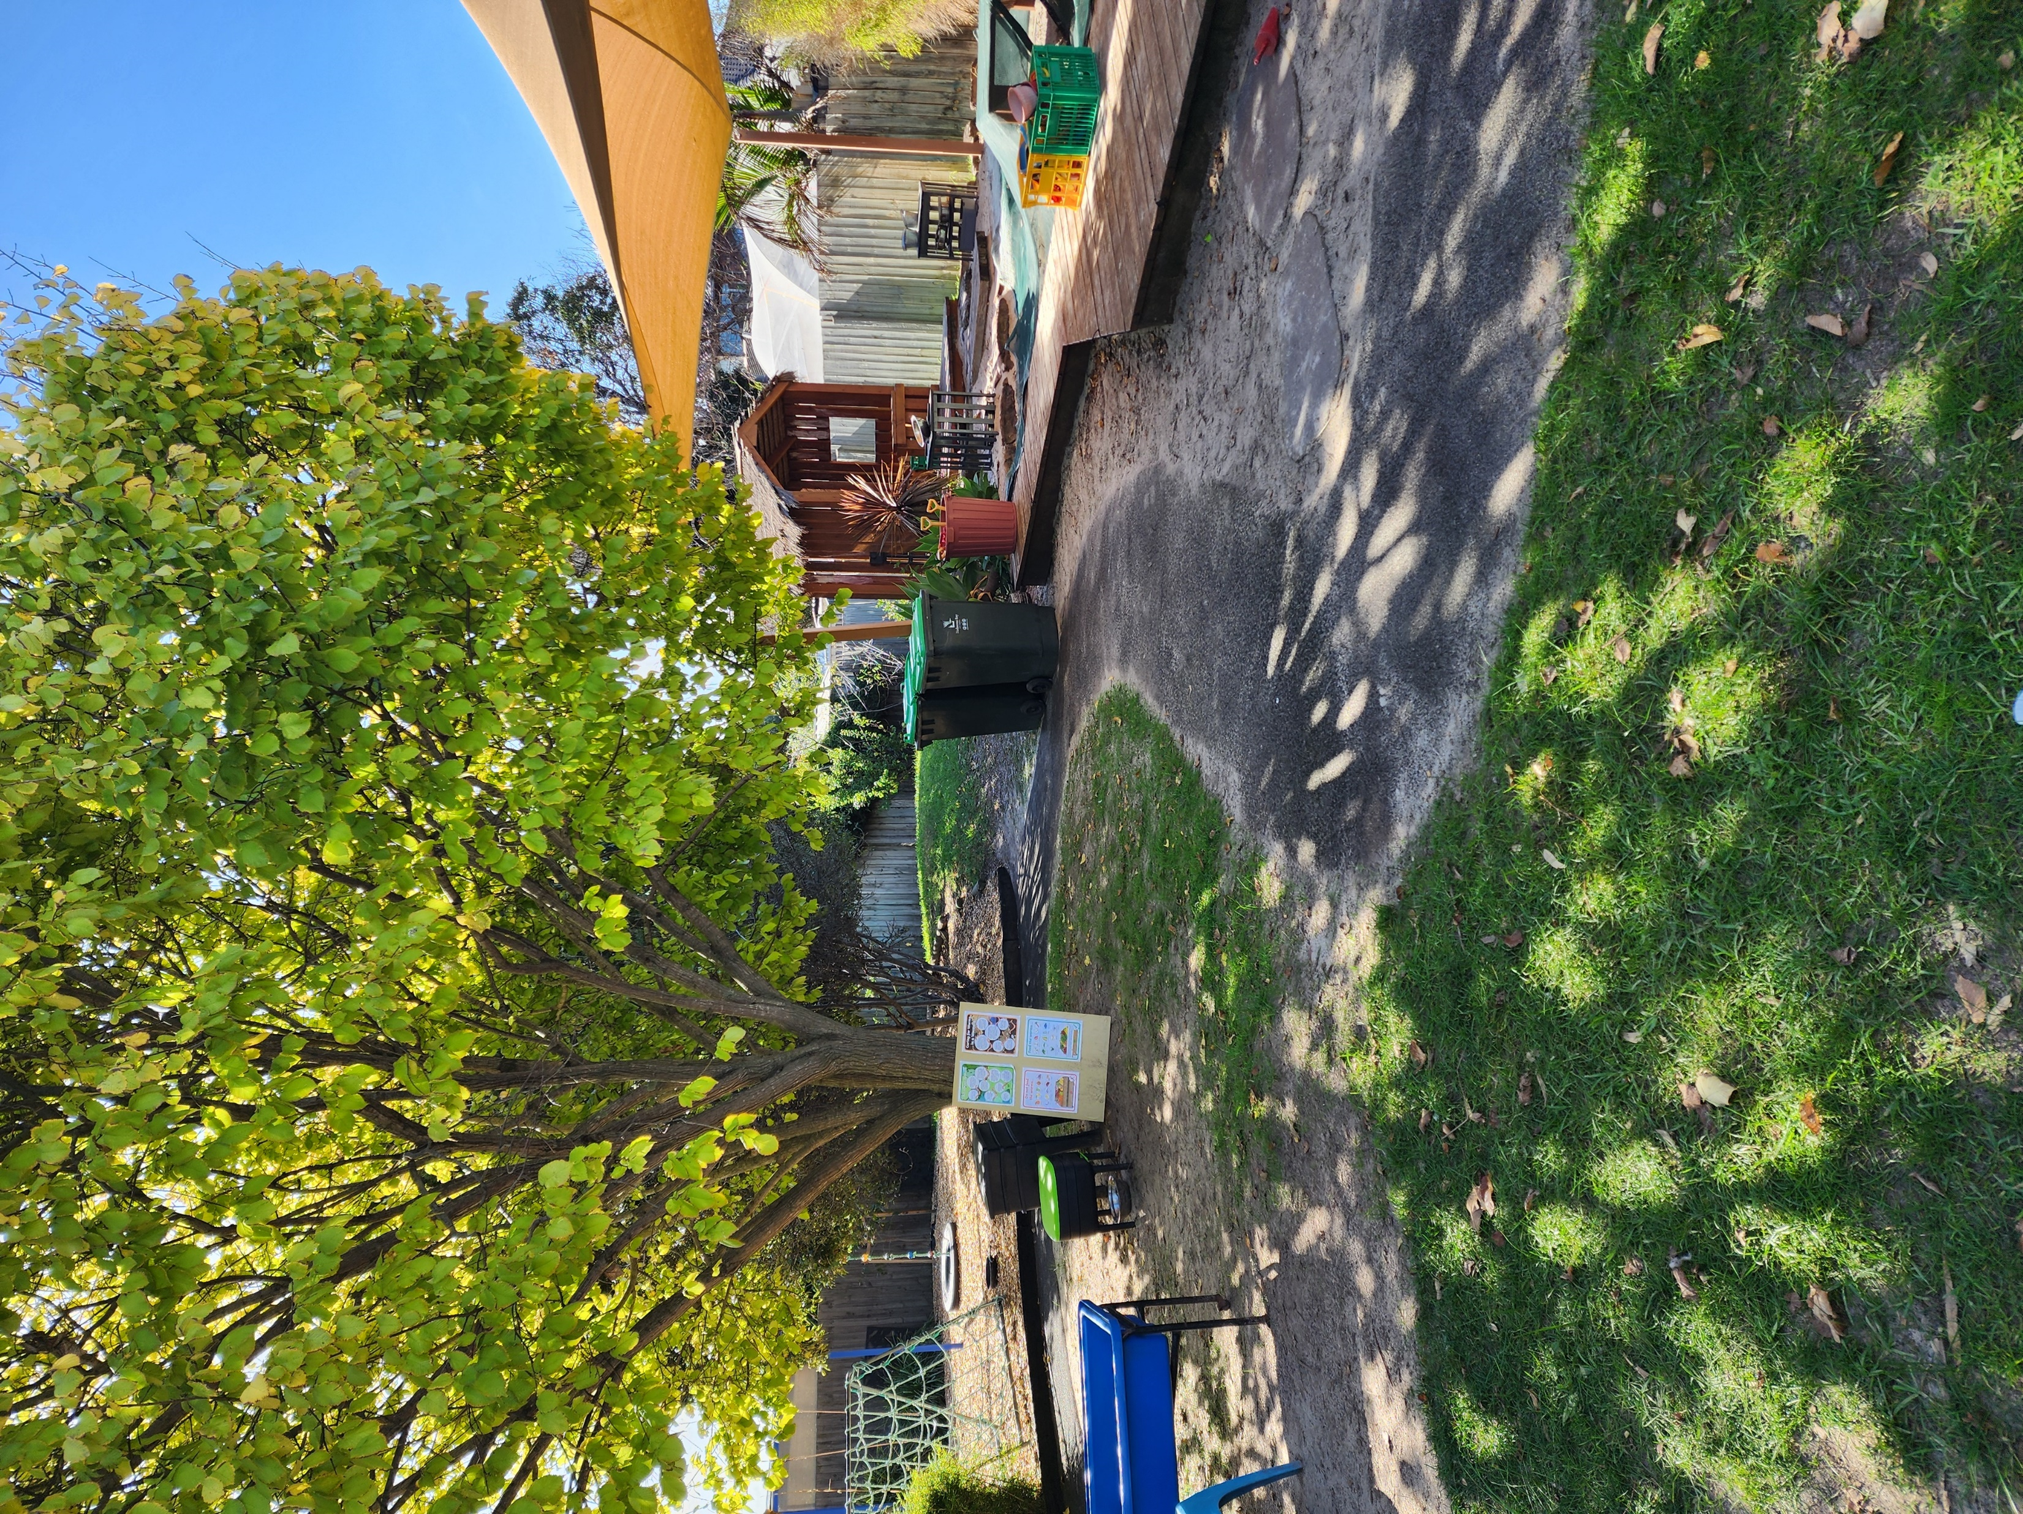
2024 Groups
Red Group 3-year-old 15 hours
Monday/Wednesday/Friday
9.15am – 2.15pm
Blue Group 4 –year-old 15 hours
Tuesdays and Thursdays
8:30am-4:00pm
Our kindergarten routine allows for both indoor and outdoor play within a spacious stimulating environment. The environments provide an atmosphere that is welcoming, supportive, safe, motivating, and inclusive. Children are encouraged and supported by our caring and knowledgeable educators to become self-reliant, take initiative, overcome obstacles, explore, imagine, collaborate and find solutions, nurturing a passion for knowledge, curiosity, creativity and learning.
Altona Meadows Kindergarten was established in 1977.
At Altona Meadows Kindergarten, we believe that a child’s early years are a unique and valuable time in their lives and it is essential for all children’s wellbeing and learning to feel safe, happy, acknowledged and a sense of belonging and connection when attending our centre.
We acknowledge families as the child’s first teacher, recognising the value of establishing partnerships and maintaining open communication between educators and families. We respect diversity in beliefs, cultures and traditions of our families and welcome their contributions and involvement in the program.
AMK Philosophy

Slide 6
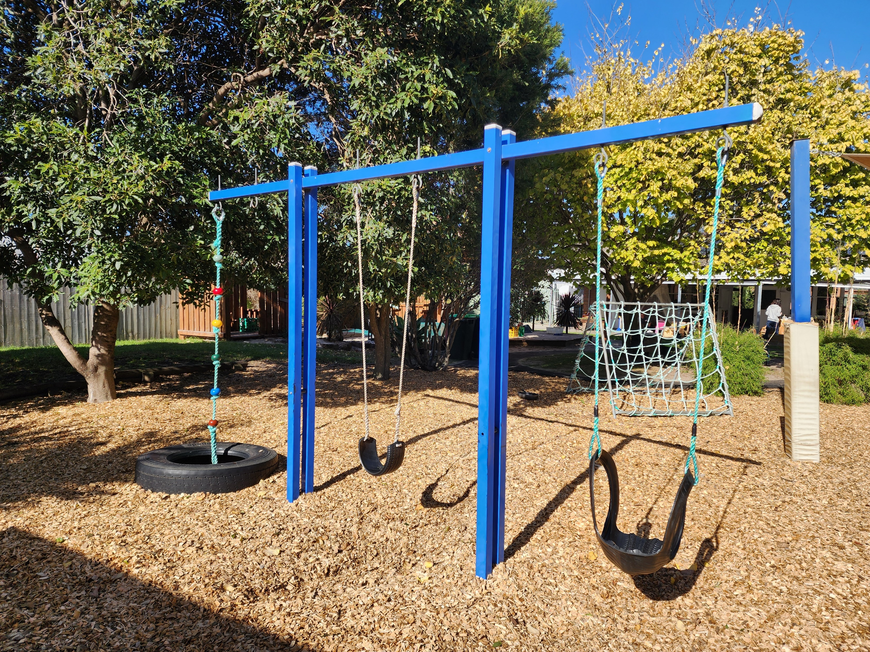
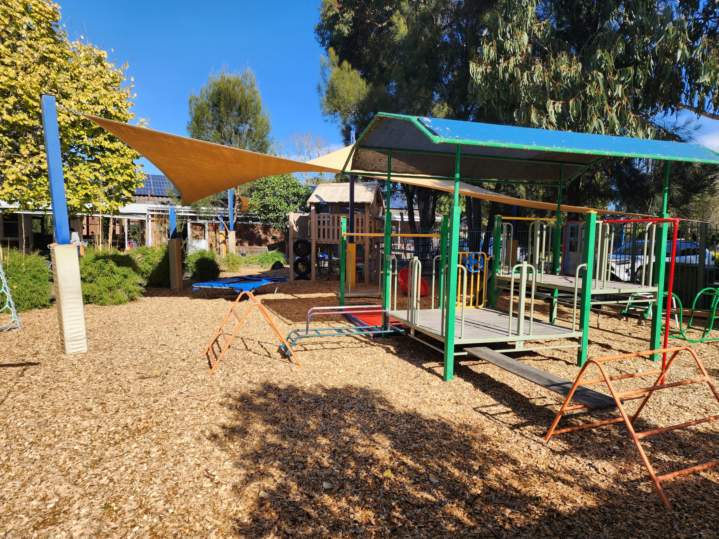
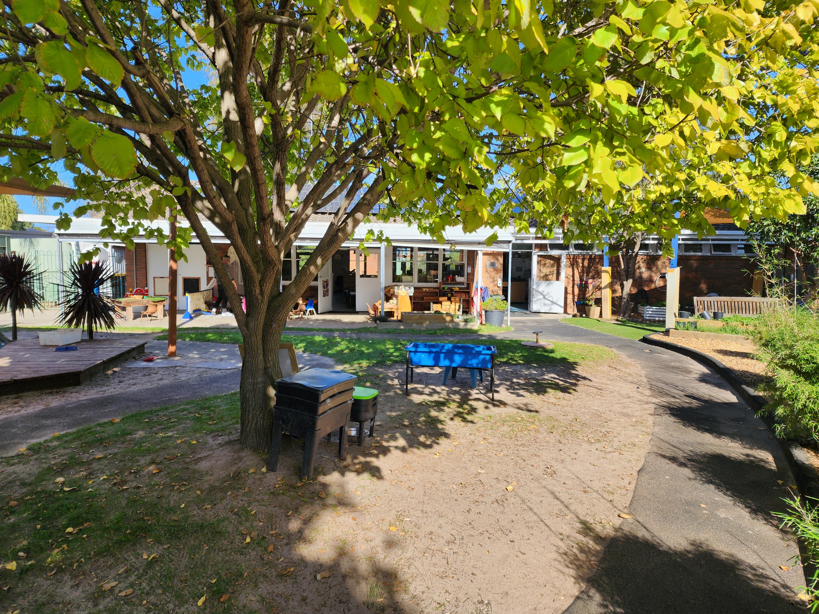
Outdoor Environment
In our expansive outdoor space, children have
the opportunity to engage in various activities. They can scale climbing structures, enjoy the vast sandpit, operate the water pump, ride bicycles along the designated track, make use of swings, freely run around. The outdoors also has numerous hidden corners where the children can explore their creativity through imaginative play or simply rest and calm during a busy day.
Thanks to donations from Bunnings Altona North and a successful Woolworths land care grant application, we have a number of garden beds in our yard. Children take on the responsibility of watering and caring for the plants, observing their growth and enjoy the produce when ready to harvest.

Slide 7
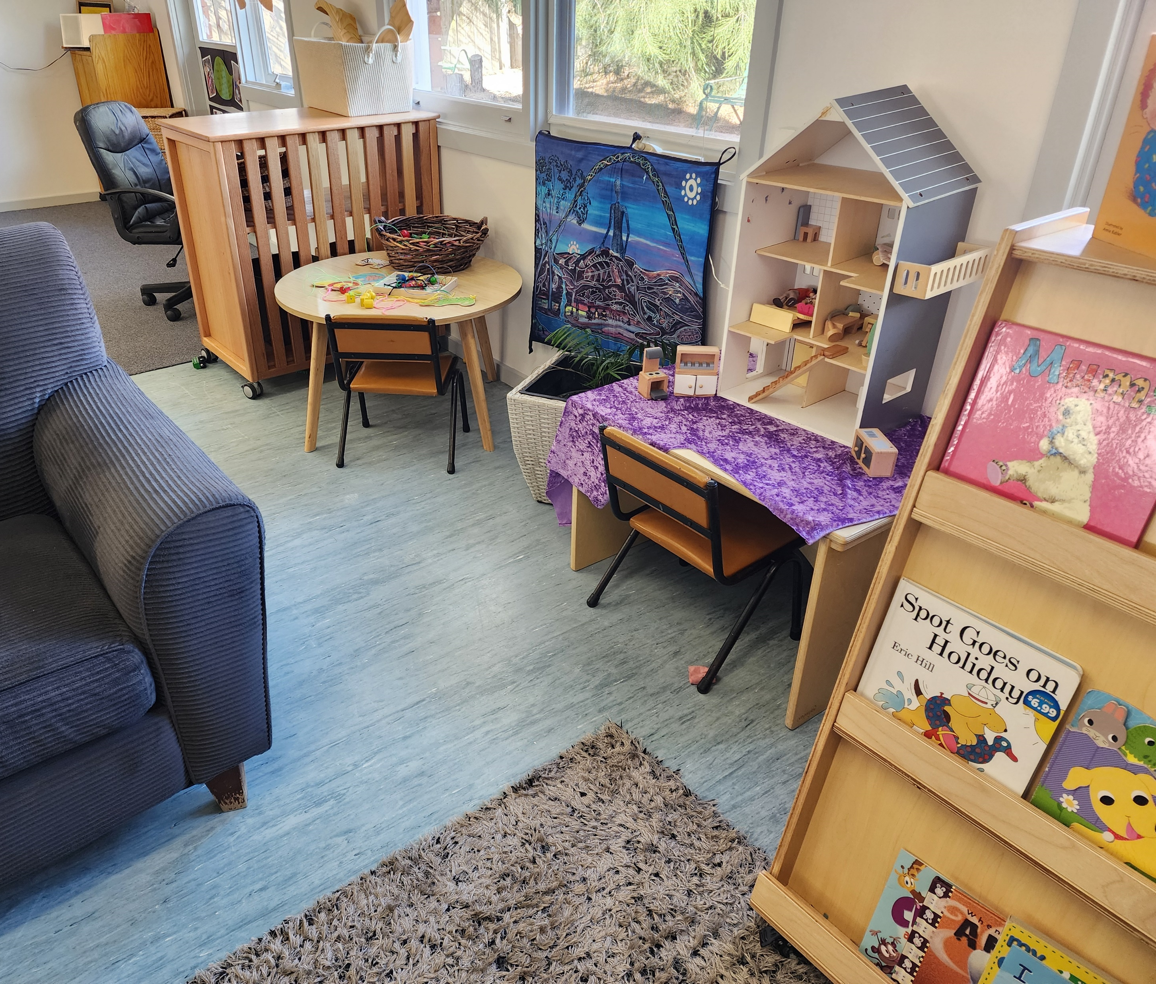
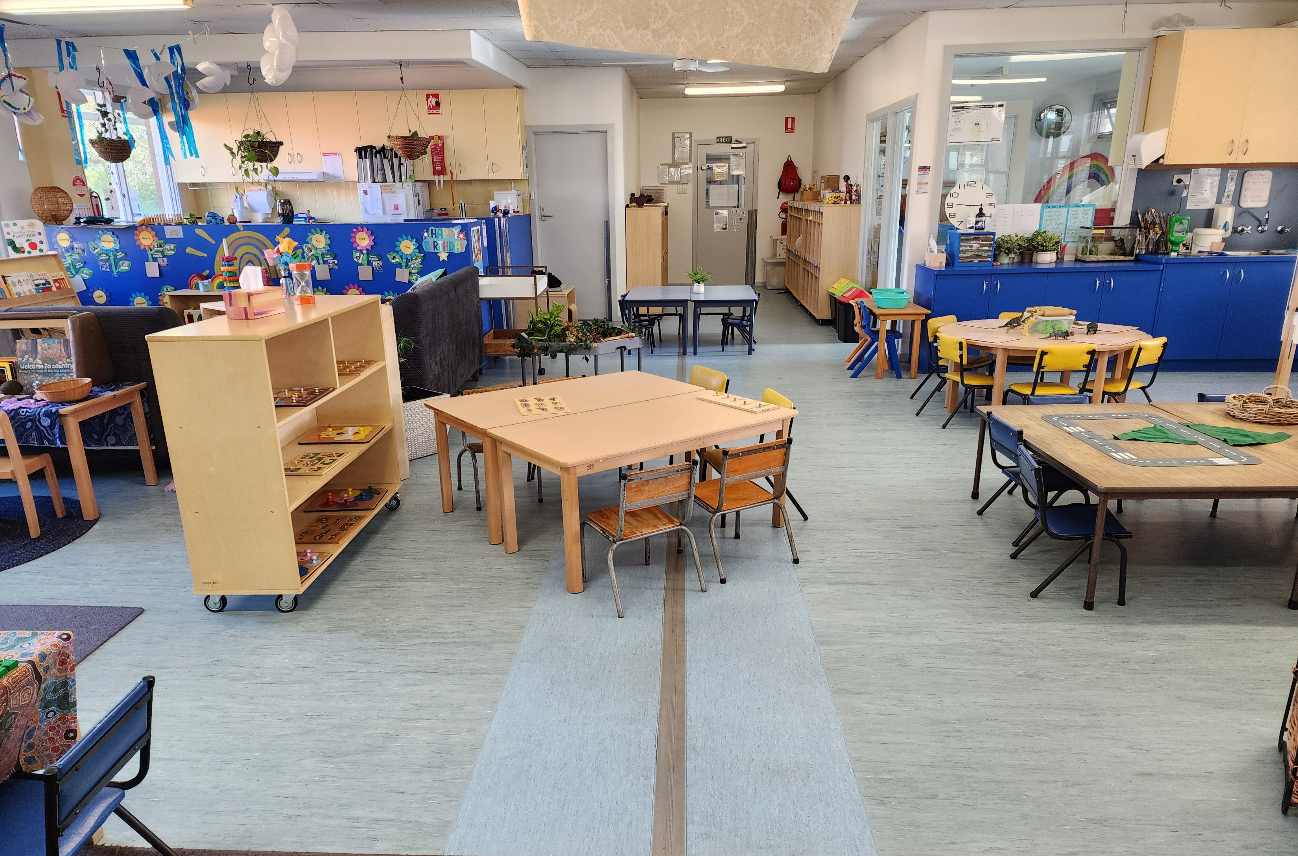
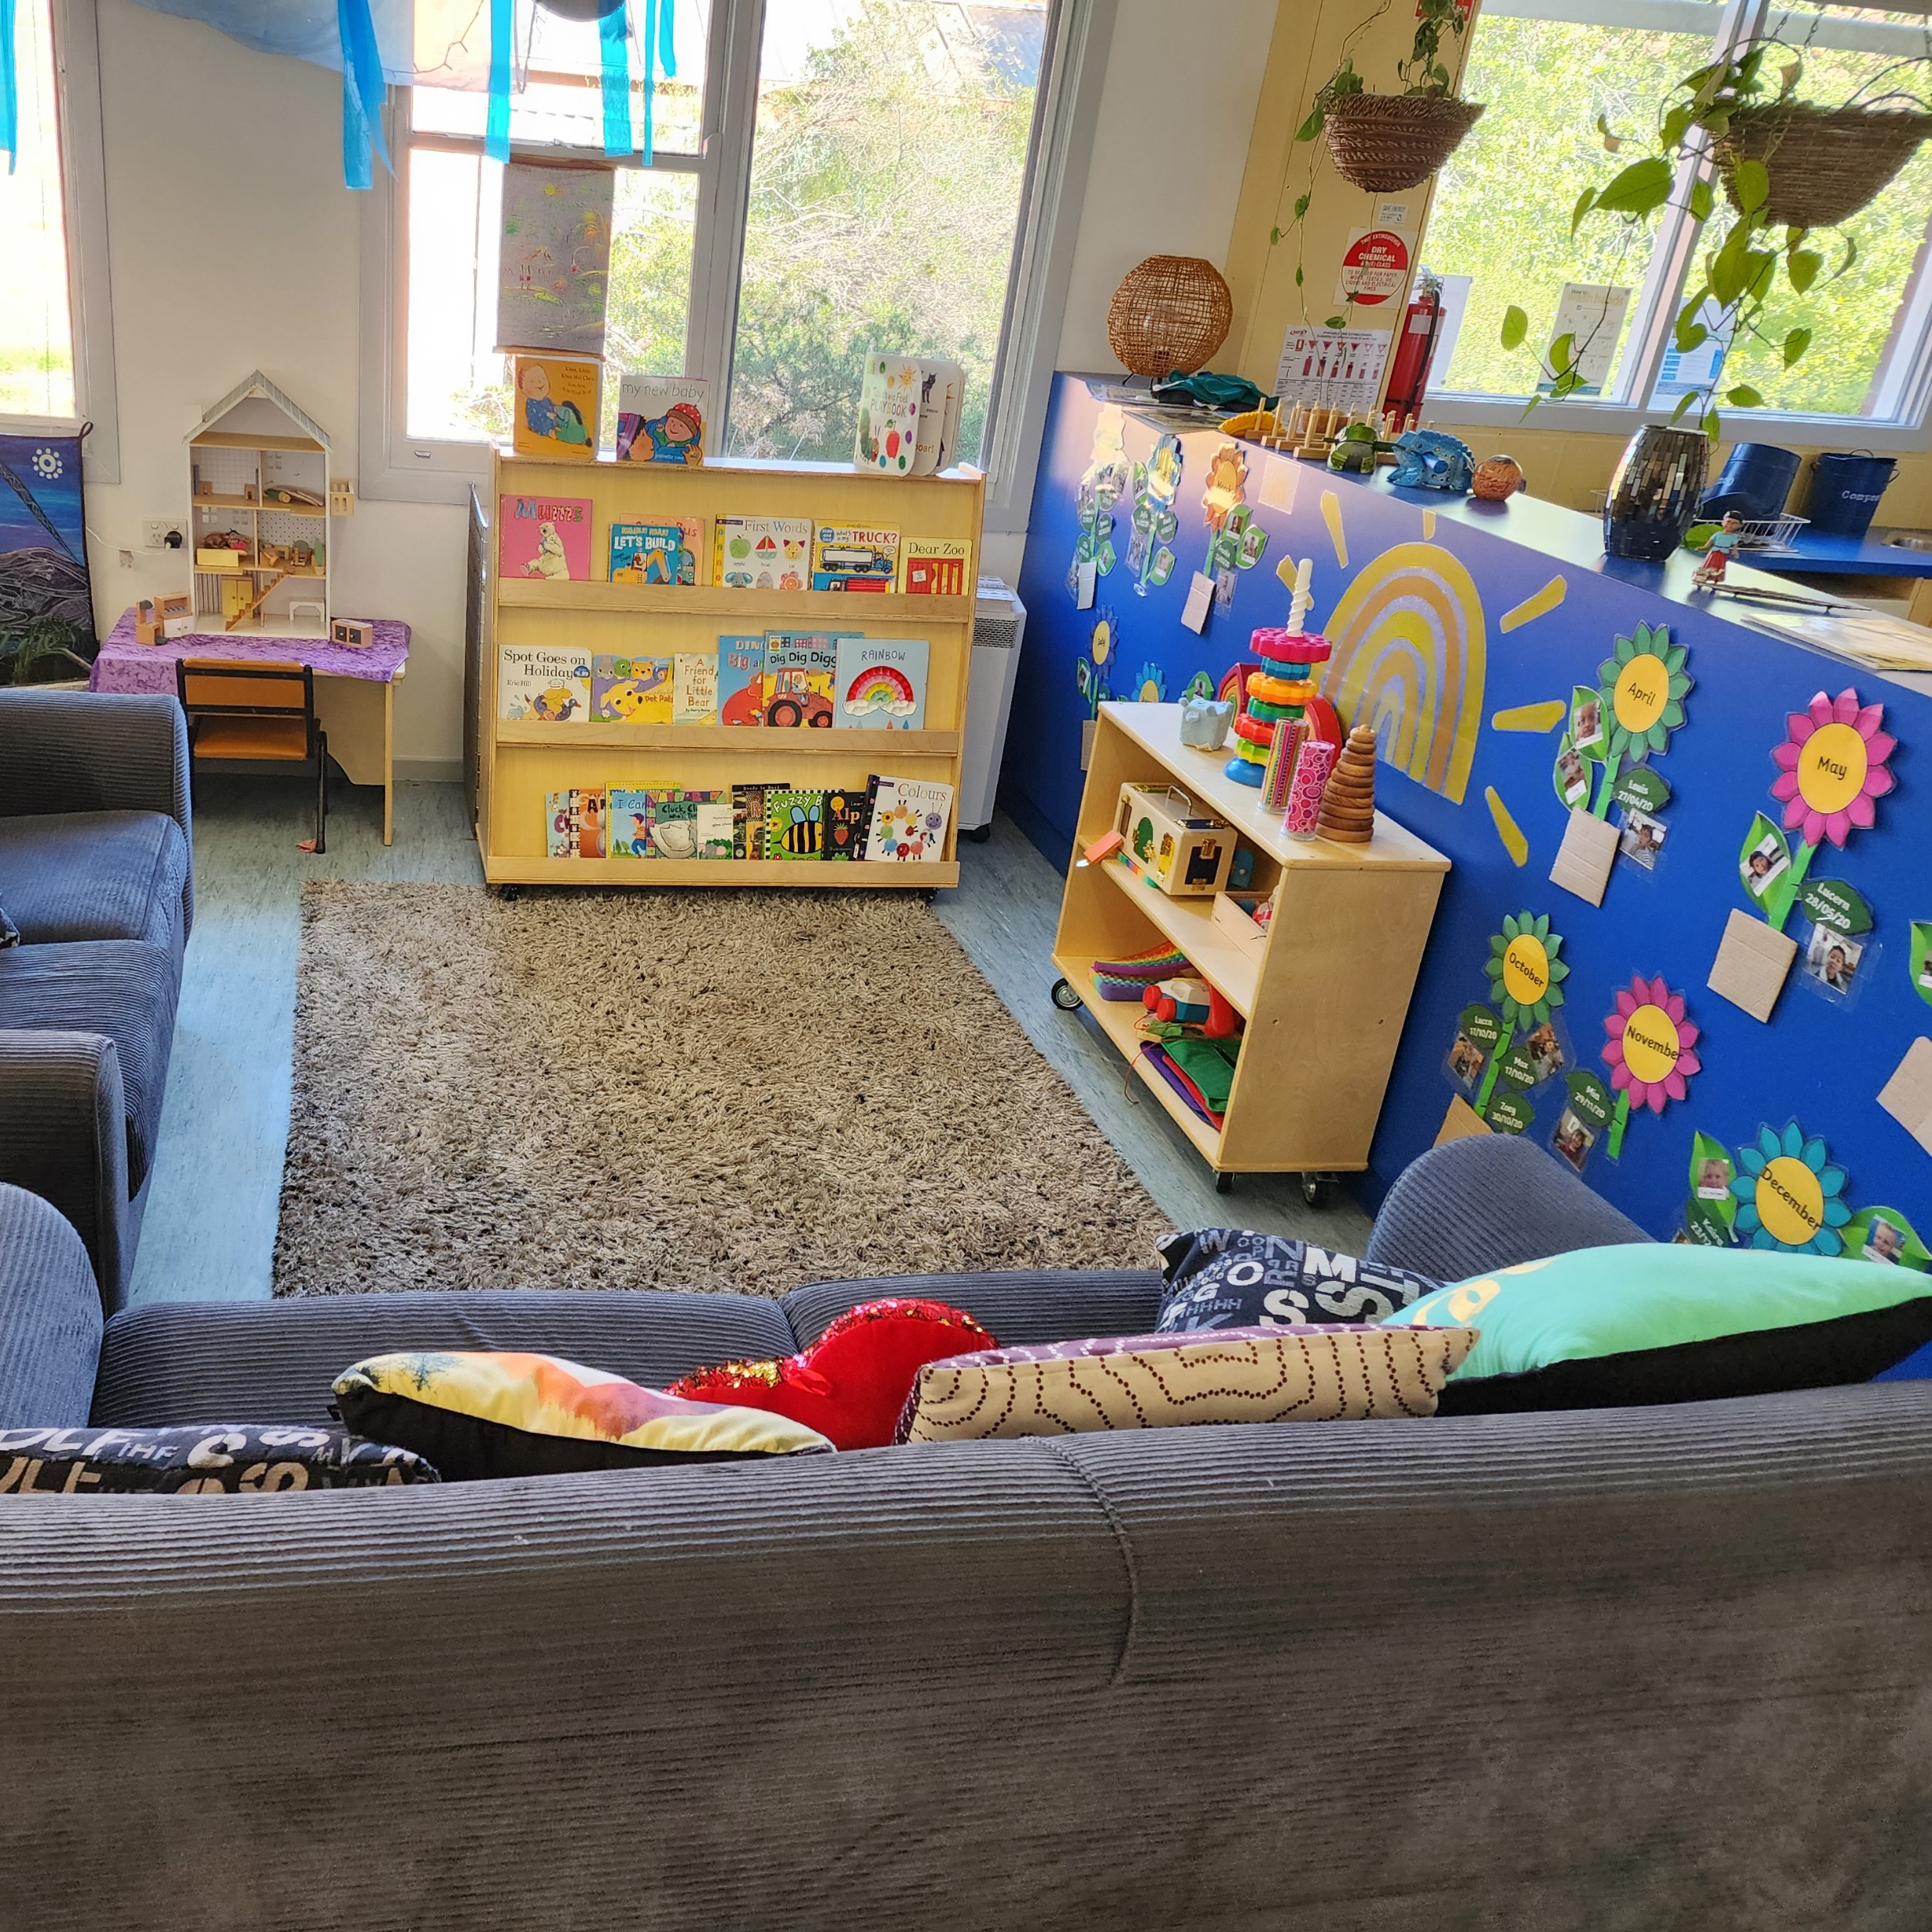
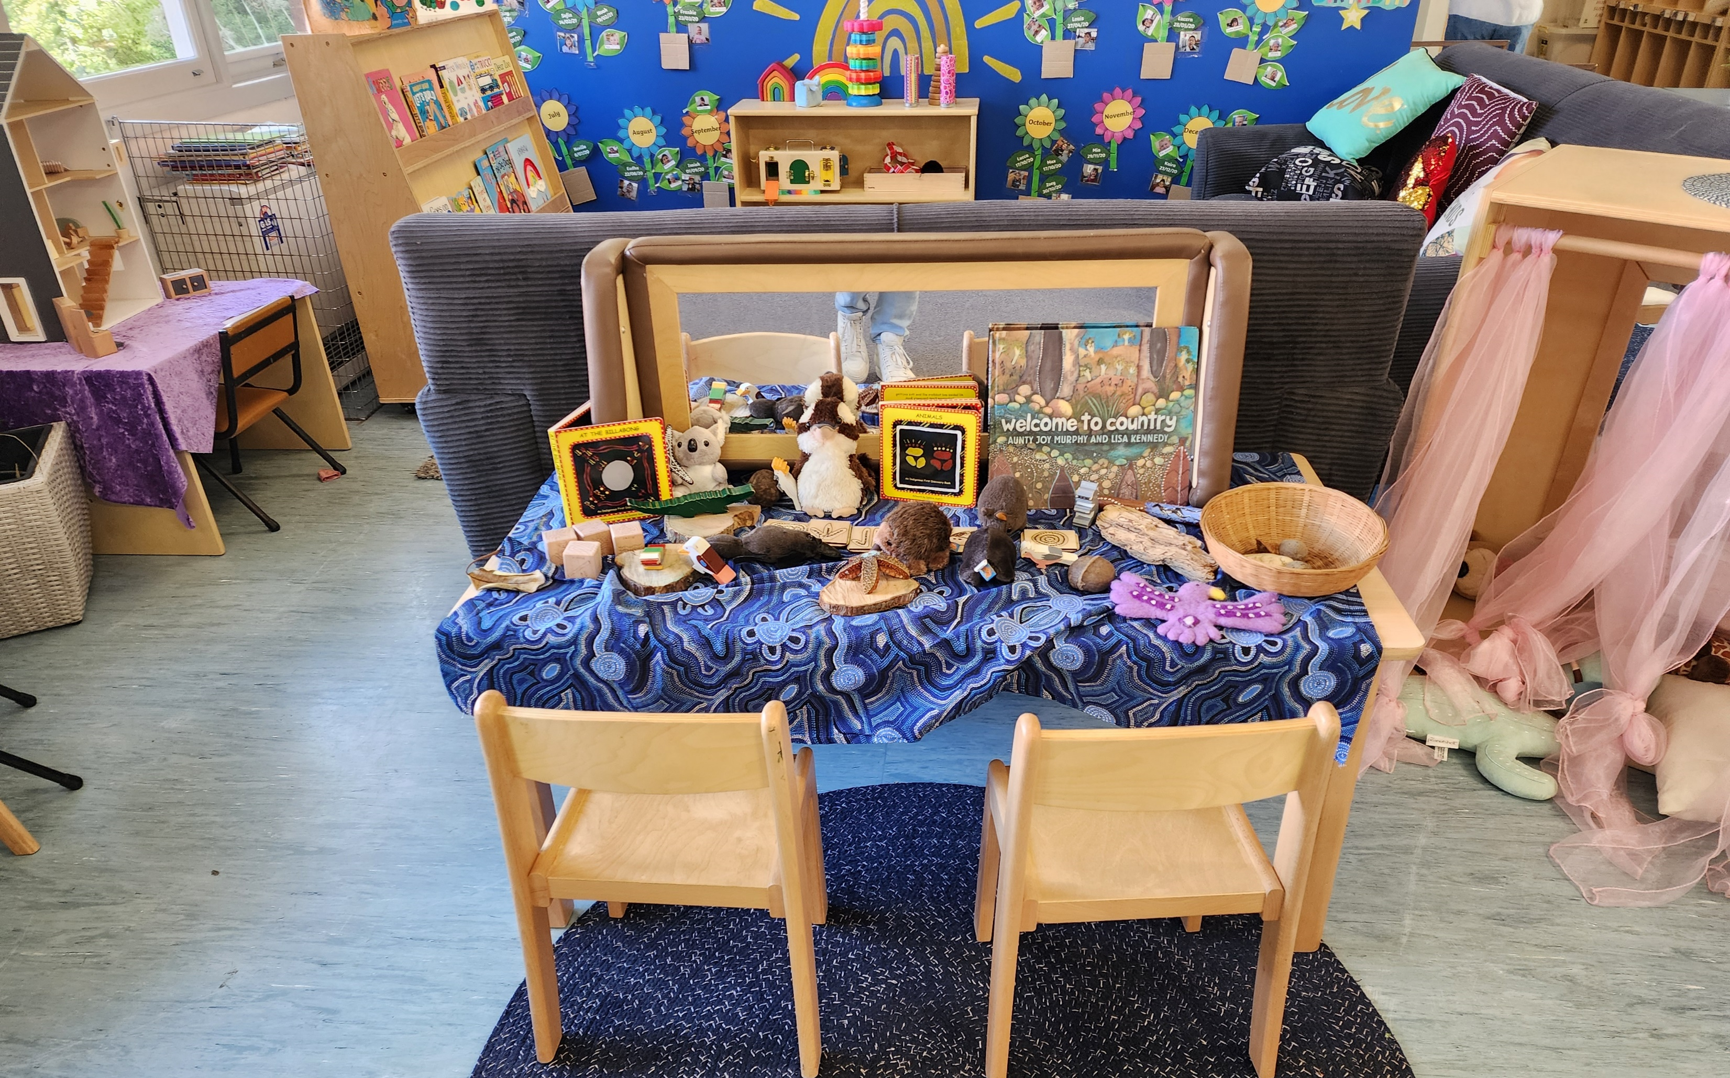
Indoor Environment
Our newly painted indoor playroom provides ample space for a range of learning activities supporting the children’s learning and development.
Children can enjoy a cozy reading corner, explore the sensory area, unleash their creativity through arts and crafts, engage in imaginative role-play, or have fun with games, puzzles and much more.

Slide 8
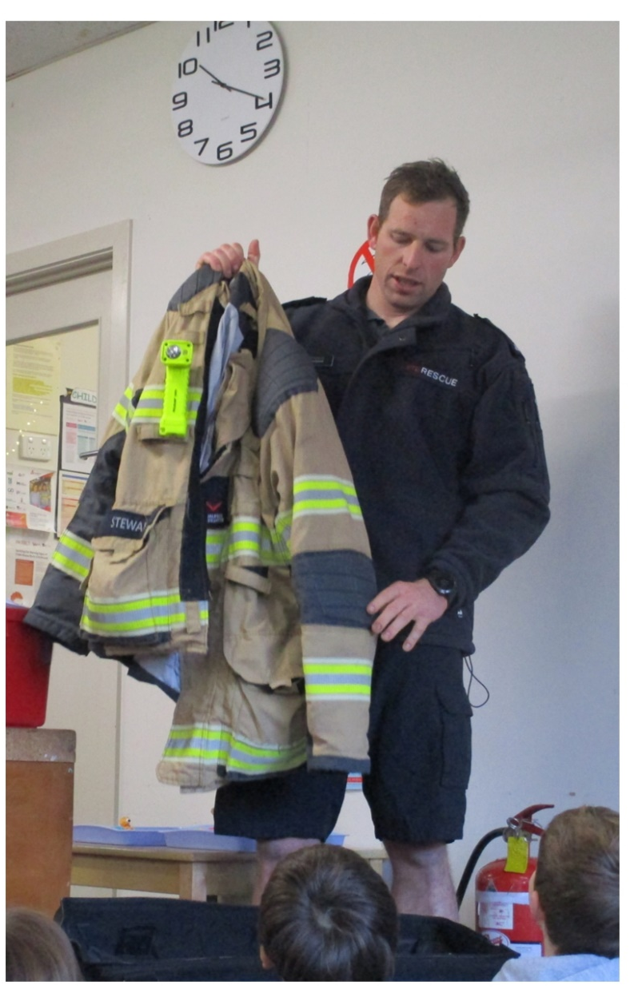
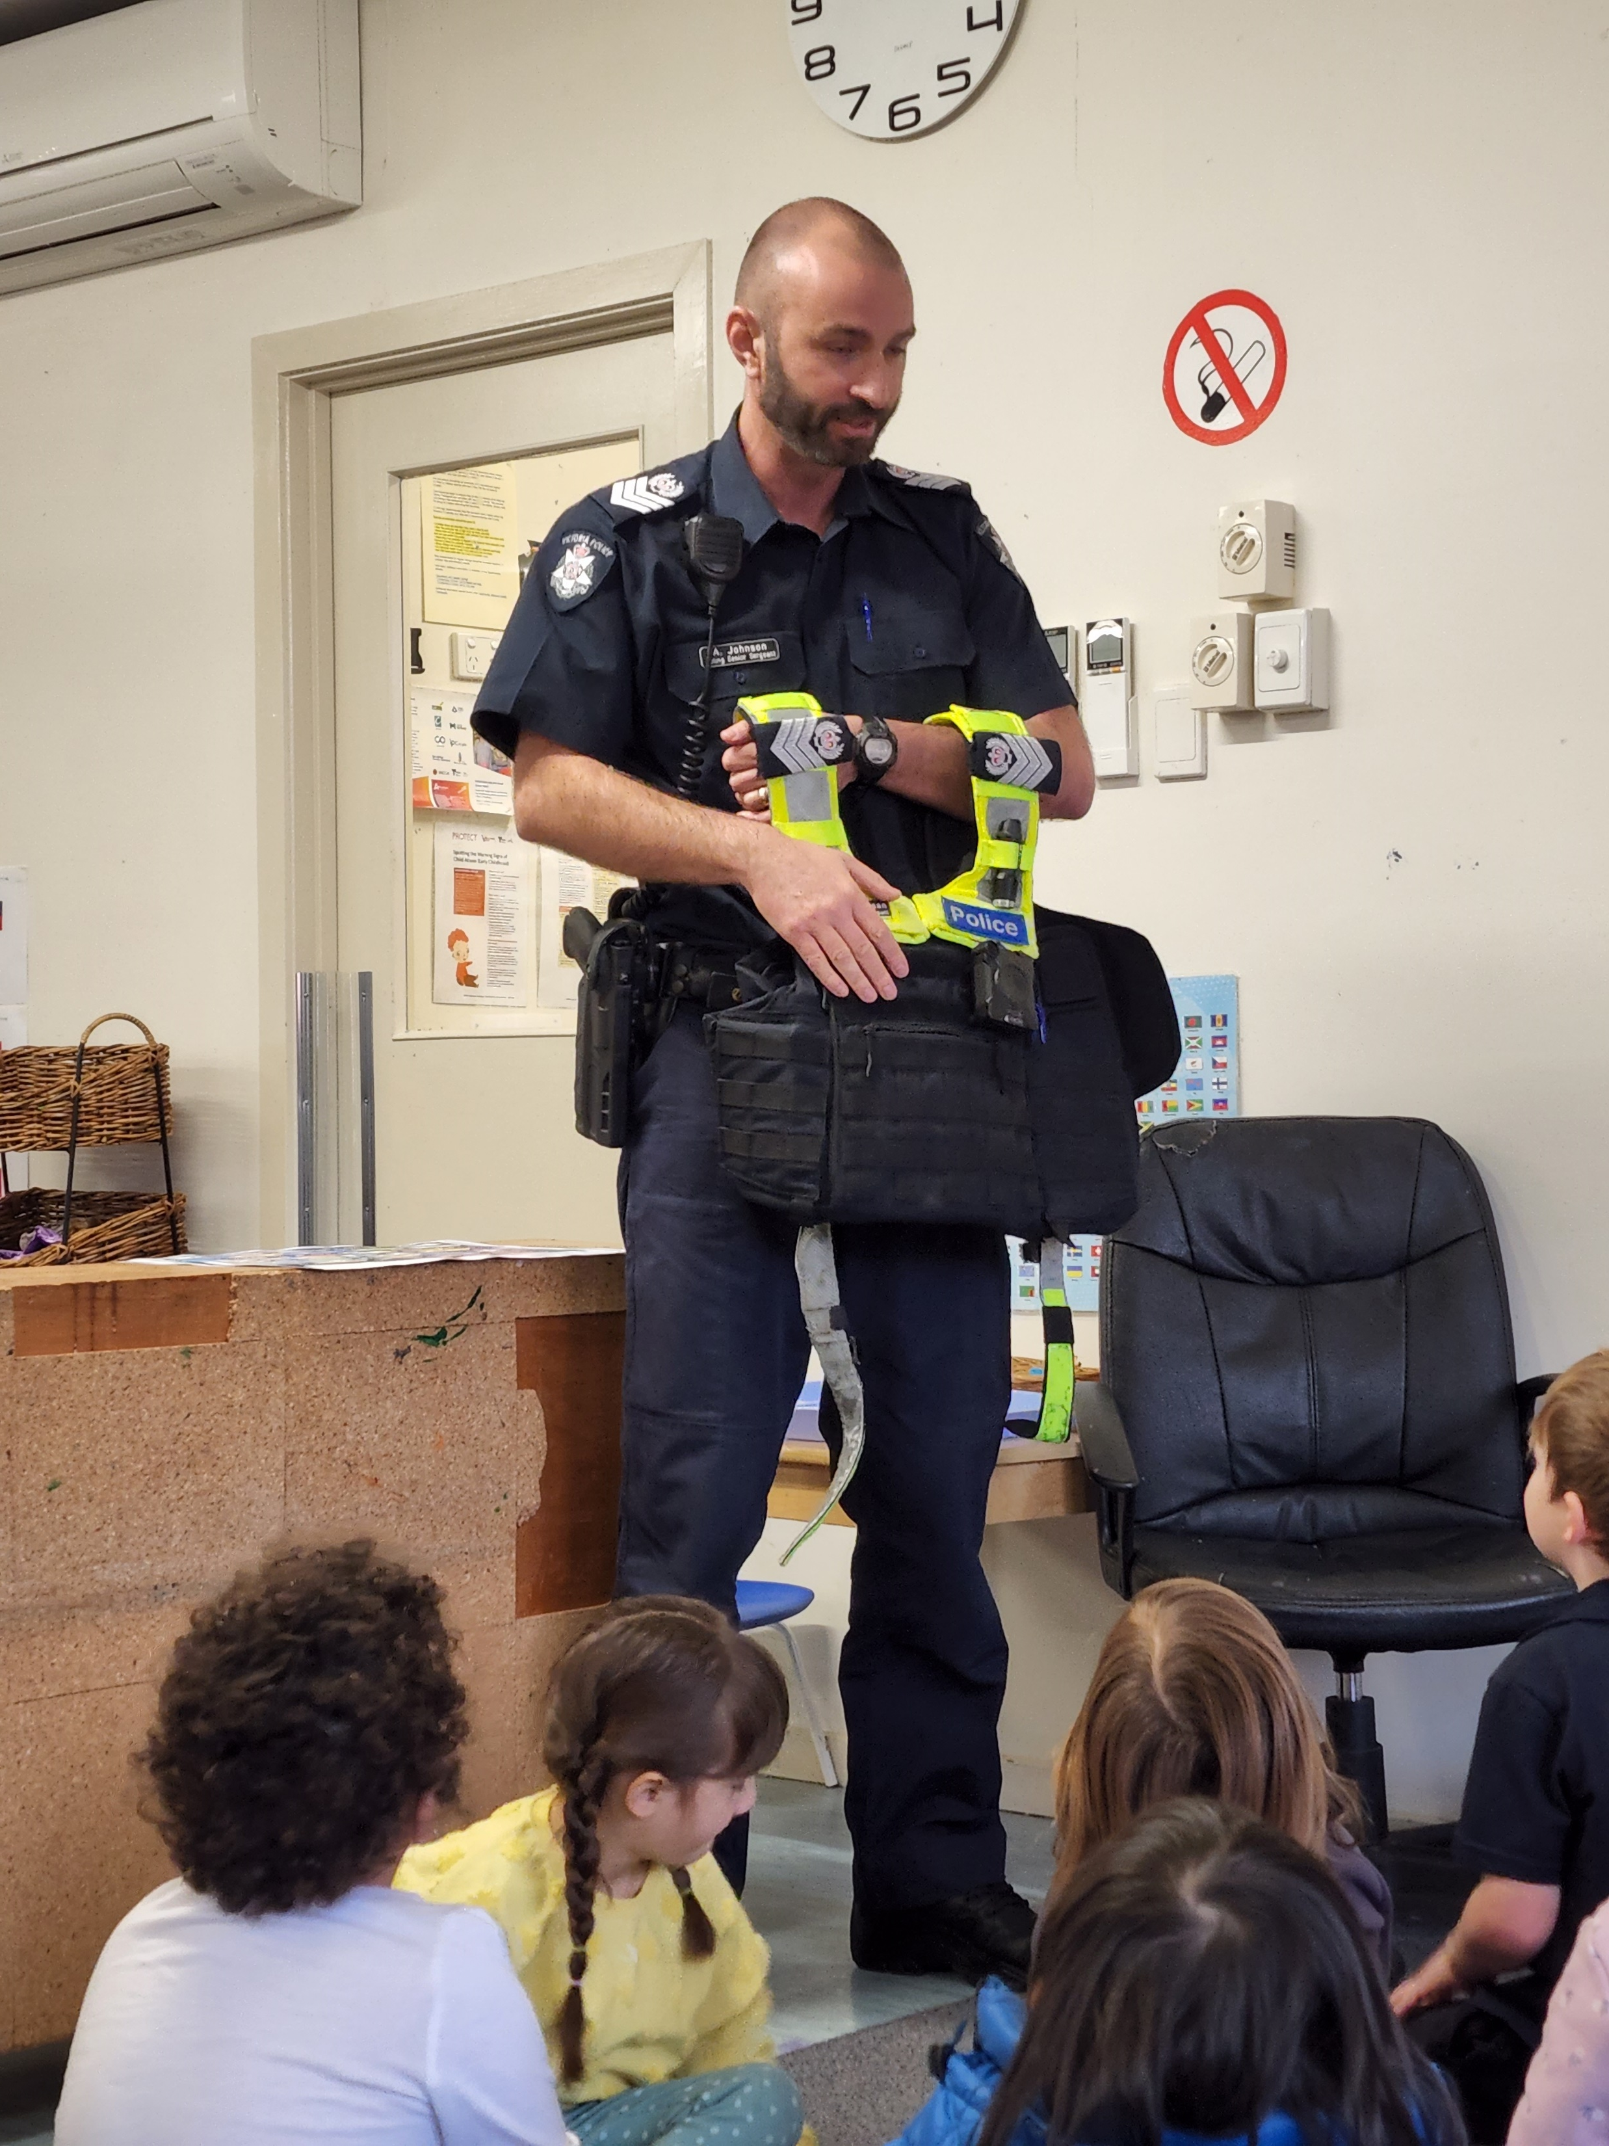
Community:
Family Picnic:
A family picnic for both groups and educators is held in March each year
Thank a responder day
Community vegetable/herb garden
Our children and families have planted a community garden at the entrance of the kindergarten. Families are welcome to help themselves to the produce to take home.
This initiative aims to foster a sense of togetherness and promote a sustainable and healthy lifestyle within our community.
Incursions/Excursions
Red group – Drama Toolbox, Vocal Enhancement Music by Kylie Cooper
Blue group – Essendon Traffic School, Altona Meadows Primary school, Responsible Pet Ownership

Slide 9
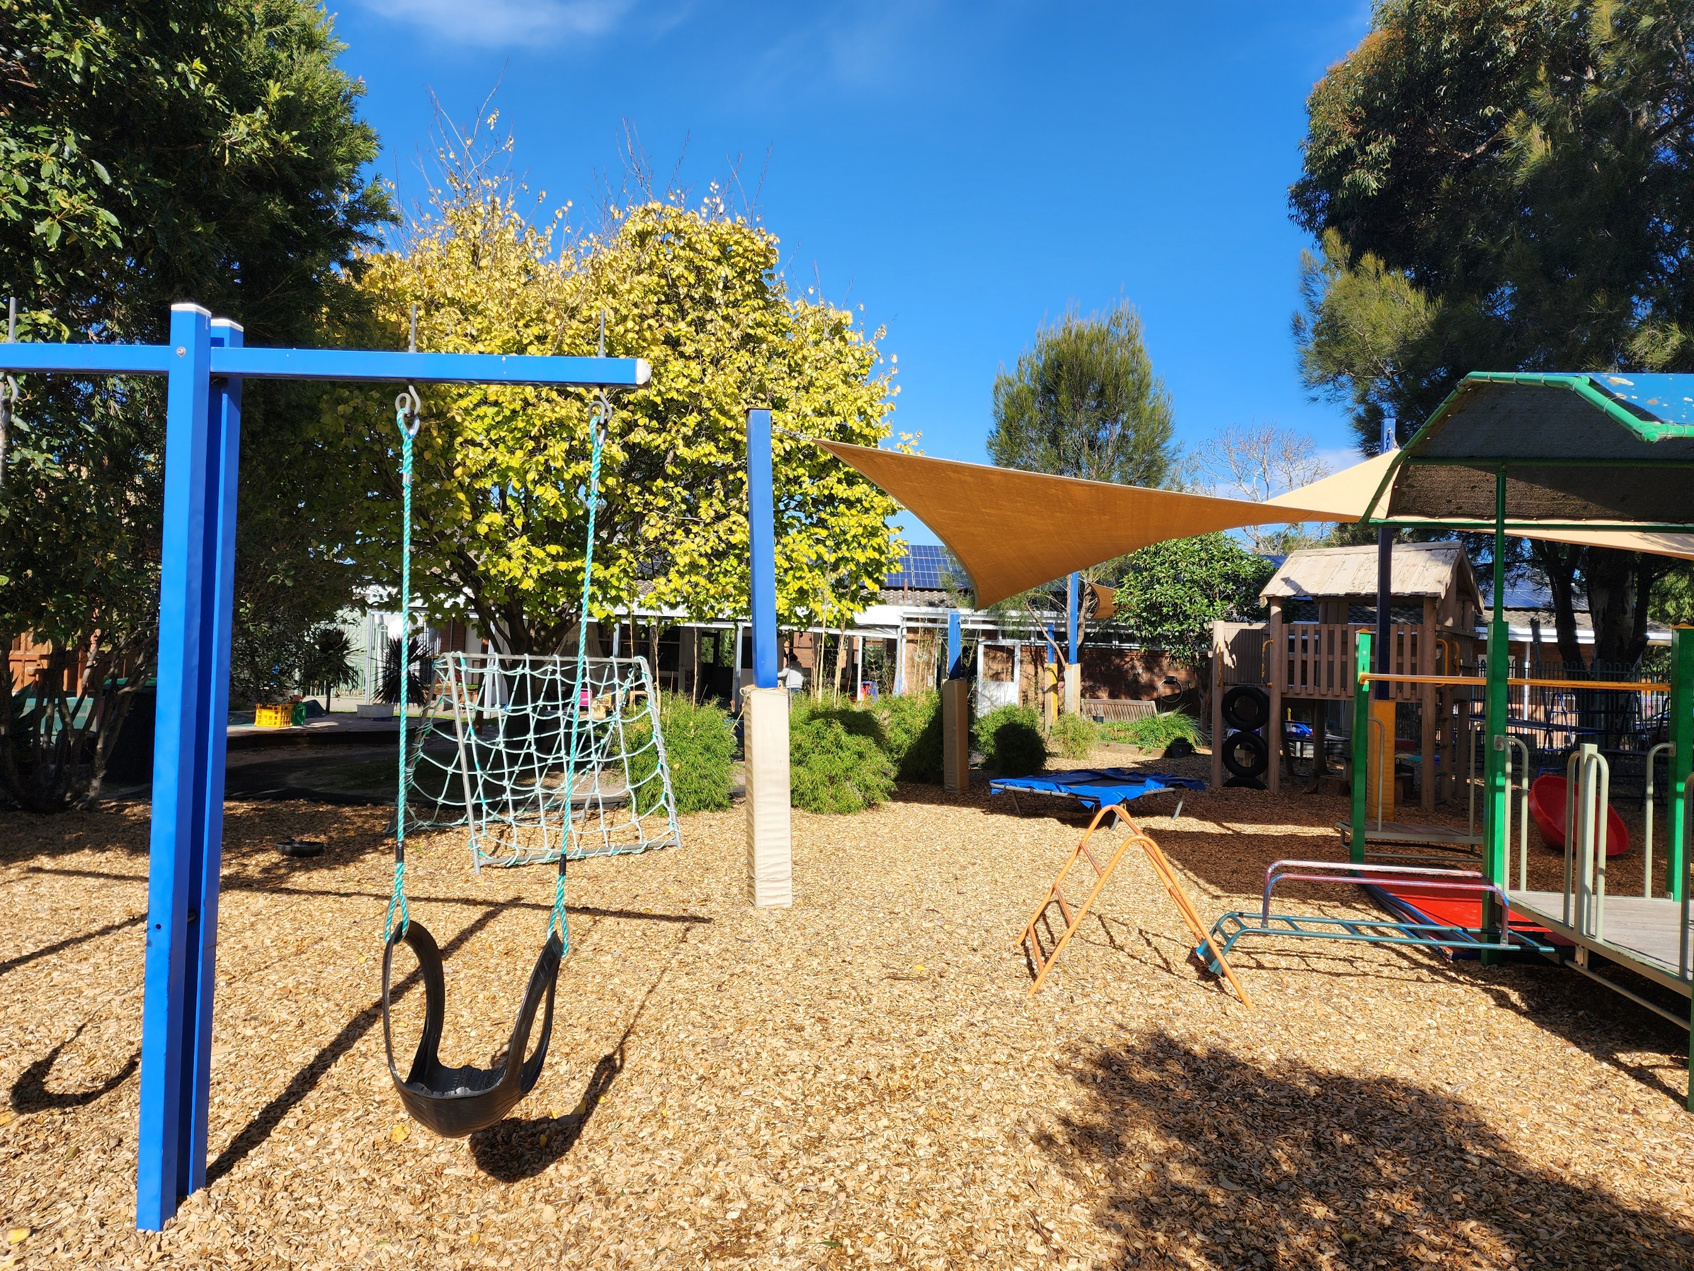
The support from the committee and families at Altona Meadows Kindergarten has always been unwavering. In return, our educators consistently exhibit dedication, passion, inclusivity, and a true love for teaching
One of the joys of being a long-established kindergarten is to witness the presence of multiple siblings who have attended our kindergarten over the years, as it allows us to reconnect with their families and build upon existing relationships. Furthermore, we are honored to have the opportunity to educate the children of past students who have fond memories of their time at Altona Meadows Kindergarten.

